Slide 1
DATING
How to have a successful date ?

Slide 2
TABLE OF CONTENTS
01
02
03
04
Introduce
Summary
Q & A
DATING
Who am I ?
Some tips to have a successful date
Brief the summary of main points
Notes:
Review somethings that you have just heard

Slide 3
01
introduce
Who am I ?

Slide 4
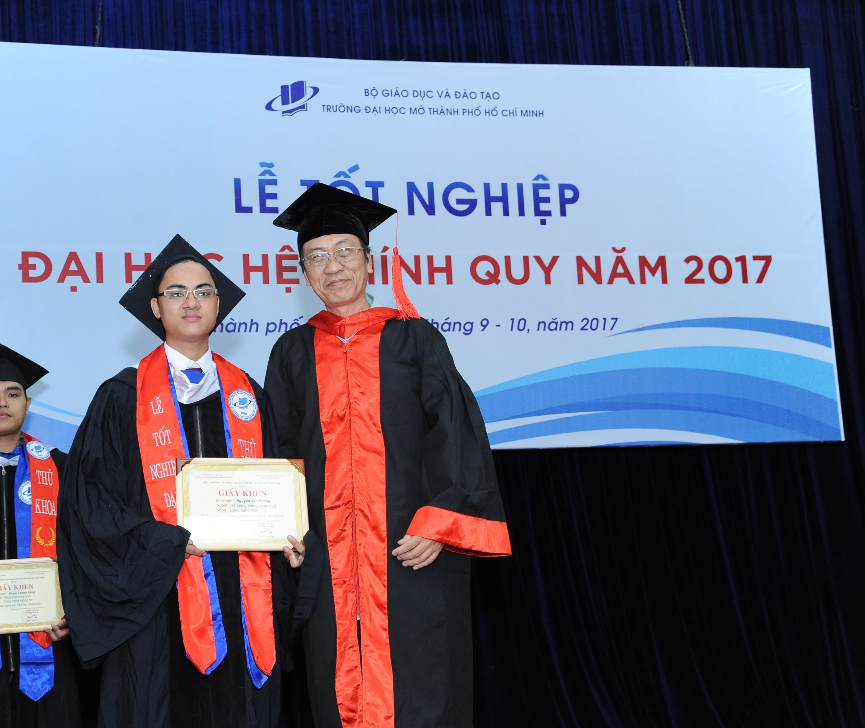

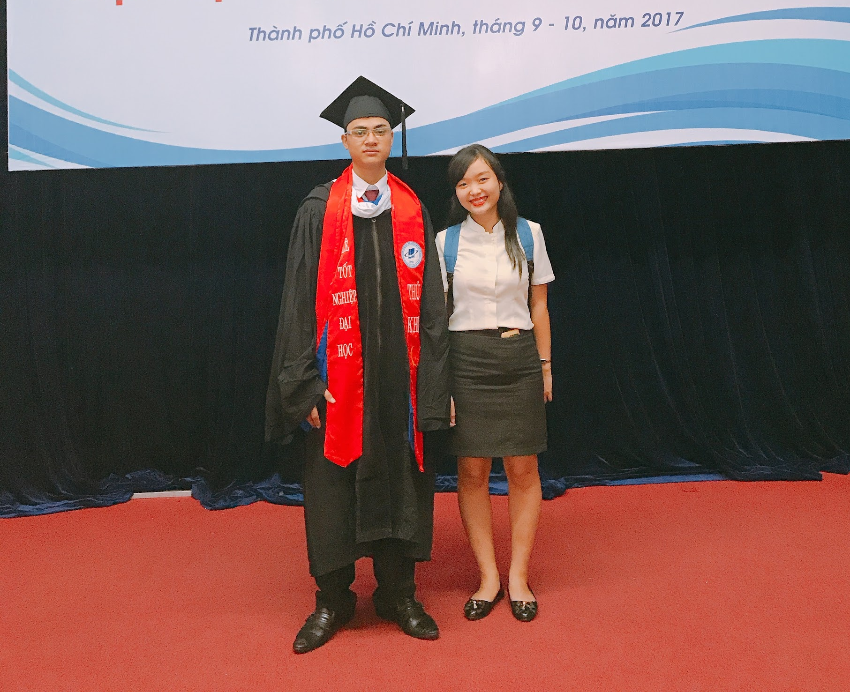

hometown
EDUCATION
occupation
Open University
Top 1 graduated student in 2017
(GPA: 8.2/10. Degree grade: Very good)
Many high awards in academic examinations
Full stack .NET Software Development Engineer 3+ years of experience (11/2019)
Notes:
First prize in a scientific research project at school level.
Excellent thesis protection with 10 points.
Won 3rd prize in robocode programming contest
Participated in ACM ICPC contest
Got many scholarships
Won Consolation prize to encourage the olympic exam at the department level

Slide 5
02
dating
Some tips to have a successful date

Slide 6
three main stages for each date
bEFORE
aFTER
DURING

Slide 7
BEFORE YOUR DATE
Make sure that you have a fresh breath
Have a prior conversation on the phone
Inform your plan and have a backup plan

Slide 8
一 will rogers
“You never get a second chance to make a first impression”
Notes:
Your first impression is important

Slide 9
during YOUR DATE
tURN OFF YOUR PHONE
Focus on the things that are right in front of you.
KEEP THE CONVERSATION FUN
BE ON TIME
Punctuality is more important than ever on a first date
BE A GOOD LISTENER
Talking About Your Ex Is Toxic
You shouldn’t talk a lot about yourself
You had not better talk about your Ex and bad-mouth your Ex
Notes:
In this ever-connected era, it can sometimes be hard to disconnect and focus on the things that are right in front of you.

Slide 10

After YOUR DATE
ending your date with a good night kiss/ hug
send your date a sweet text message

Slide 11
03
summary
Review somethings that you have just heard

Slide 12
summary
Before
during
After
Have a prior conversation on the phone
Inform your plan and have a backup plan
Make sure that you have a fresh breath
Be on time
Turn off your phone
Keep the conversation fun
Be a good listener
Talking about your Ex is toxic (/ˈtɒk.sɪk/)
Ending your date with a good night kiss/ hug
Send your date a sweet text message

Slide 13
THANKS!
Email: phongit.ou@gmail.com
Phone: 0989.681.553
Notes:
https://www.flaticon.com/packs/dating-app-12

Slide 14
Q & A

Slide 15
Resources
https://www.aconsciousrethink.com/11834/first-date-tips-after-meeting-online/

